Slide 1
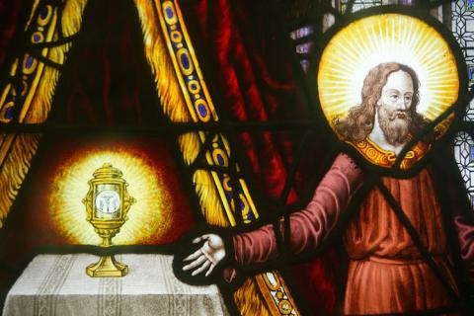
Perl 6
Der heilige Gral

Slide 2

Suche nach dem ver...

Slide 3
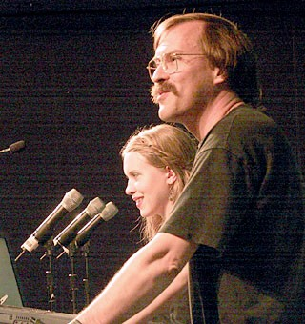
19. Juli 2000

Slide 4
Perl 6 Design
Apokalypsen
Exegesen
Synopsen

Slide 5
Perl 6 Design
Apokalypsen
Exegesen
Synopsen

Slide 6
Perl 6 Design
Apokalypsen
Exegesen
Synopsen
wiki.perl-community.de/bin/view/Wissensbasis/PerlTafel
http://perl-6.de/

Slide 7
Perl 6 Design
p6l (perl6-language@perl.org)
#perl6 (irc.freenode.org/perl6)

Slide 8
Perl 6 Design
p6l (perl6-language@perl.org)
#perl6 (irc.freenode.org/perl6)
Larry Wall, Damian Conway, Patrick R. Michaud, Allison Randal, chromatic

Slide 9
Perl 6 Design
p6l (perl6-language@perl.org)
#perl6 (irc.freenode.org/perl6)
Larry Wall, Damian Conway, Patrick R. Michaud, Allison Randal, chromatic
Dan Sugalski, Luke Palmer, Audrey Tang

Slide 10
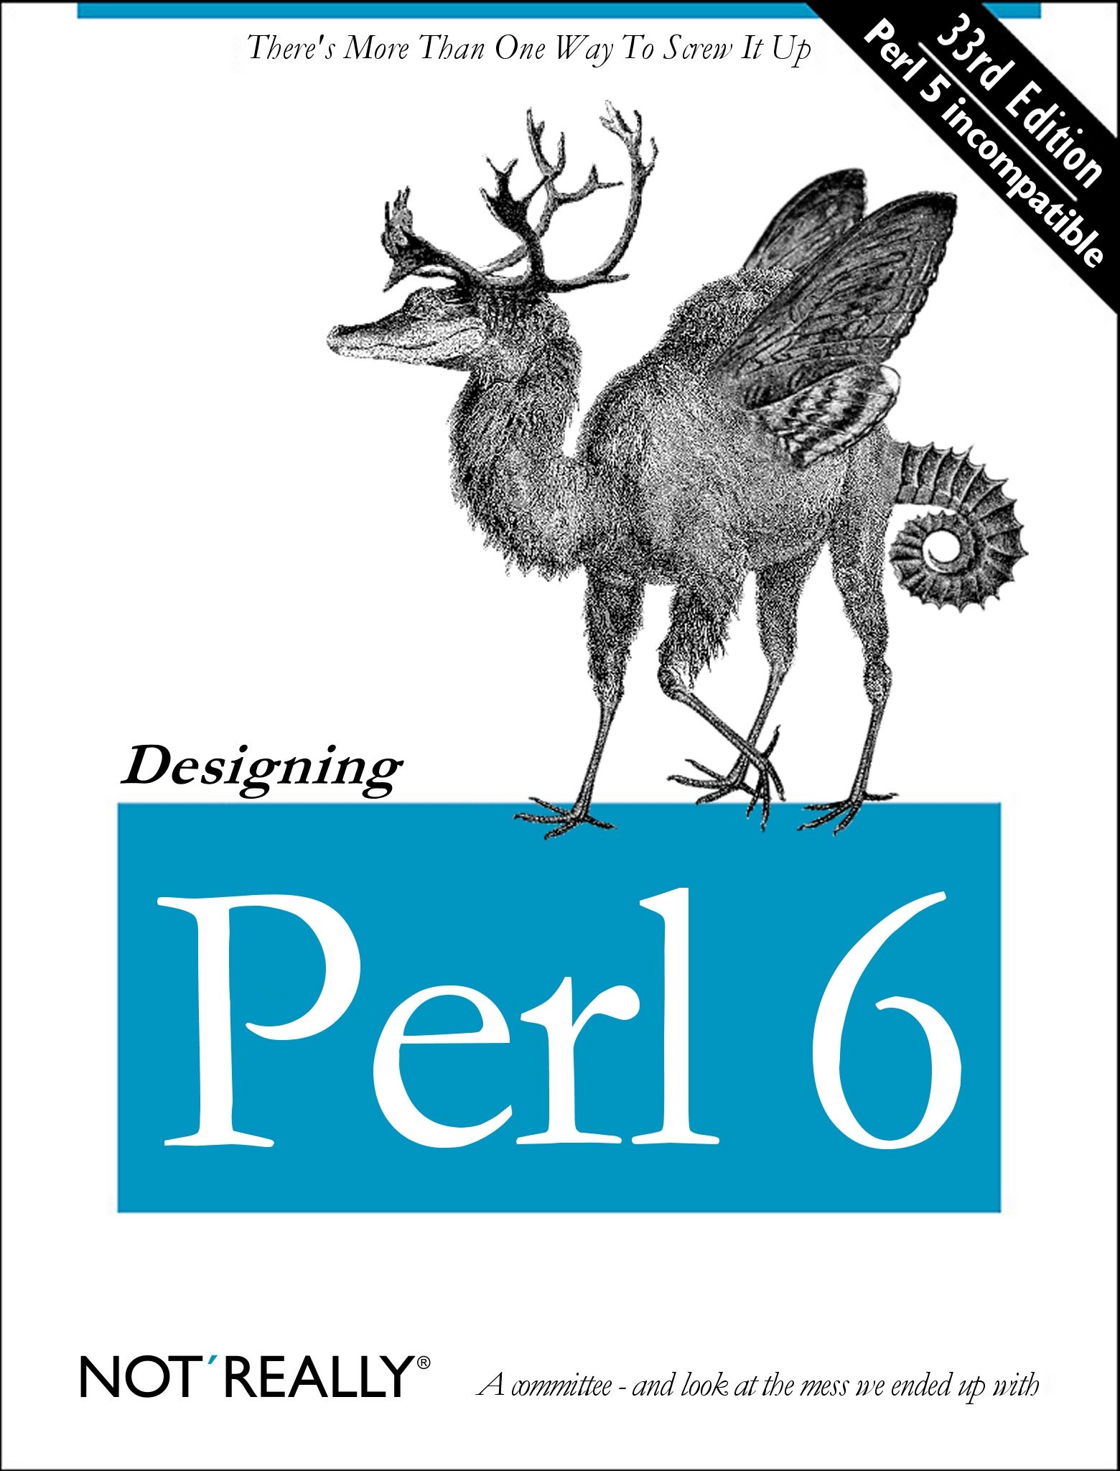
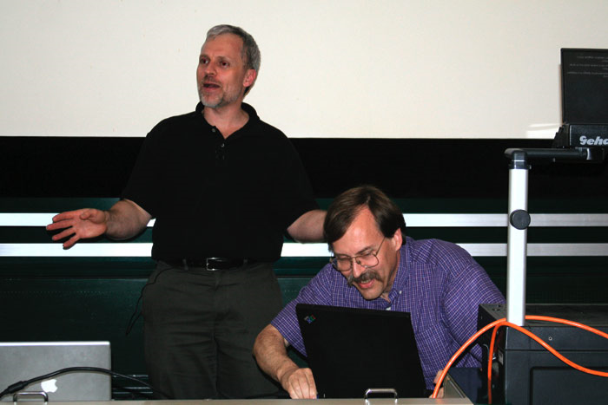
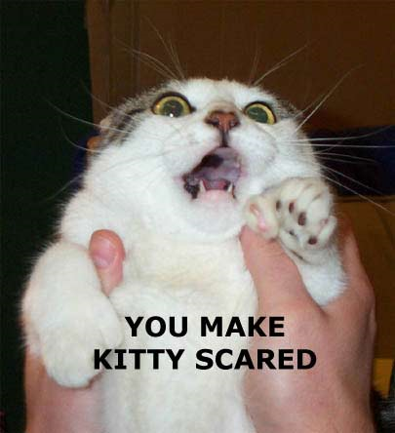
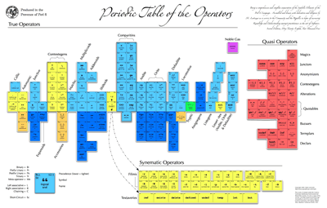

Slide 11
Parrot

Slide 12
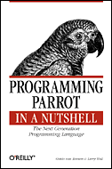
1. April 2001

Slide 13
Parrot Code
#copy stdin to stdout, except for lines starting with #
while left_angle_right_angle:
if dollar_underscore[0] =eq= "#":
continue_next;
}
print dollar_underscore;
}

Slide 14
Parrot
VM (Virtuelle Maschine)

Slide 15
Parrot
VM (Virtuelle Maschine)
Software - CPU

Slide 16
Parrot
VM (Virtuelle Maschine)
native/magische Register

Slide 17
Parrot
VM (Virtuelle Maschine)
native/magische Register
Continuations

Slide 18
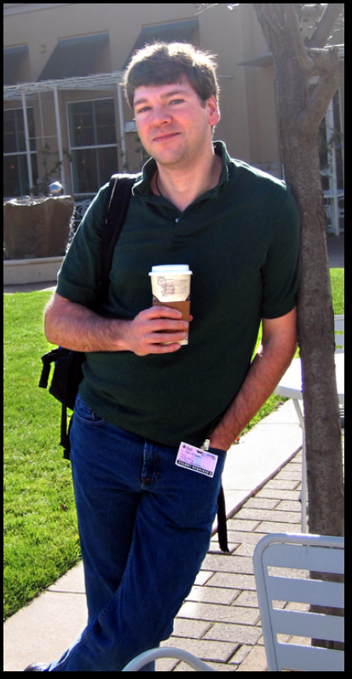
Parrot
VM (Virtuelle Maschine)
native/magische Register
Continuations
Dan Sugalski

Slide 19
Parrot
VM (Virtuelle Maschine)
native/magische Register
Continuations
Dan Sugalski
Mastermind

Slide 20
Parrot
VM (Virtuelle Maschine)
native/magische Register
Continuations
Dan Sugalski
Mastermind - Einzelkämpfer

Slide 21
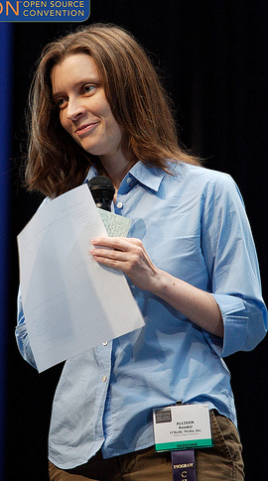
Parrot
VM (Virtuelle Maschine)
native/magische Register
Continuations
Dan Sugalski
Allison Randal

Slide 22
Allison Randal
Exchefin der Perl Foundation

Slide 23
Allison Randal
Exchefin der Perl Foundation
Parrot Leiterin

Slide 24
Allison Randal
Exchefin der Perl Foundation
Parrot Leiterin
Parrot Hacker

Slide 25
Allison Randal
Exchefin der Perl Foundation
Parrot Leiterin
Parrot Hacker
Specschreiber

Slide 26
Allison Randal
Exchefin der Perl Foundation
Parrot Leiterin
Parrot Hacker
Specschreiber
TGE / Punie

Slide 27

Parrot's Sprachen

Slide 28
Parrot's Sprachen
.pbc Parrot bytecode

Slide 29
Parrot's Sprachen
.pbc Parrot bytecode
.pasm P. Assembler

Slide 30
Pasm
new P0, 'PerlArray'
set I0, 100000
time N0
lp1:
push P0, I0
dec I0
if I0, lp1
time N1
sub N1, N0
print "constr.time "
print N1
print "\n"

Slide 31
Parrot's Sprachen
.pbc Parrot bytecode
.pasm P. Assembler
.pir P. Intermed. Repr.

Slide 32
PIR
.sub main :main
$I0 = 0 # initialized
if $I0 goto l1
$I1 = 1 # init in block 1
goto l2
l1:
$I1 = 2 # init in block 2
l2:
print $I0
print $I1 # all paths leading here do init
print "\n"
end
.end

Slide 33
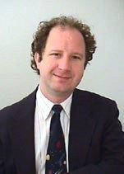
Parrot's Sprachen
.pbc Parrot bytecode
.pasm P. Assembler
.pir P. Intermed. Repr.
PGE P.Grammar Engine

Slide 34
Parrot's Sprachen
.pbc Parrot bytecode
.pasm P. Assembler
.pir P. Intermed. Repr.
PGE P.Grammar Engine

Slide 35
Parrot's Sprachen
.pbc Parrot bytecode
.pasm P. Assembler
.pir P. Intermed. Repr.
PGE P.Grammar Engine
NQP Not Quit Perl 6

Slide 36
Parrot's Sprachen
.pbc Parrot bytecode
.pasm P. Assembler
.pir P. Intermed. Repr.
PGE P.Grammar Engine
NQP Not Quite Perl 6

Slide 37
Patrick Michaud
Parrot
Parrot Compiler Tools
PGE
Rakudo

Slide 38
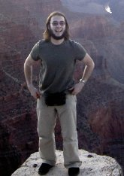
Rakudo
PCT
Patrick Michaud, Jonathan Worthington

Slide 39
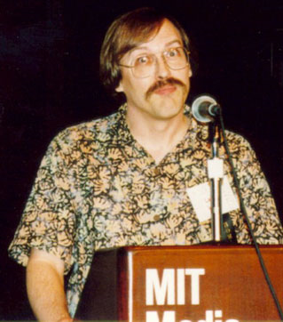
STD.pm
Syntaxregeln
in P6 rules
Bootstrapping

Slide 40
elf
STD.pm parsen
mithilfe von Ruby

Slide 41
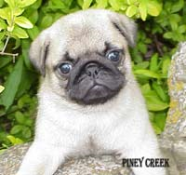

Pugs
Audrey Tang
GHC
Perl 6 Users Golfing System
junction
-O Fun

Slide 42
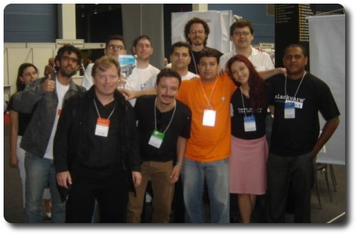
kp6
Flavio Glock
mp6
p5
pugs

Slide 43
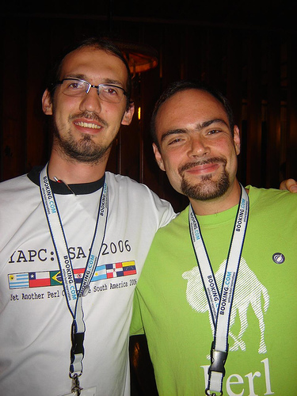
SMOP
Daniel Ruoso
runloop
in C
simple MOP
sm0p / s1p

Slide 44
Syntax

Slide 45
Variablen
$ @ %

Slide 46
Variablen
$scalar $scalar
@array @array
$array[0] @array[0]
$array[-1] @array[*-1]
@array[0..3] @array[0..3]
%hash %hash
$hash{'key'} %hash{'key'}
$hash{'key'} %hash<key>
@hash{'k1','k2'} %hash<k1 k2>

Slide 47
Variablen
$scalar $scalar
@array @array
$array[0] @array[0]
$array[-1] @array[*-1]
@array[0..3] @array[0..3]
%hash %hash
$hash{'key'} %hash{'key'}
$hash{'key'} %hash<key>
@hash{'k1','k2'} %hash<k1 k2>

Slide 48
Variablen
$scalar $scalar
@array @array
$array[0] @array[0]
$array[-1] @array[*-1]
@array[0..3] @array[0..3]
%hash %hash
$hash{'key'} %hash{'key'}
$hash{'key'} %hash<key>
@hash{'k1','k2'} %hash<k1 k2>

Slide 49
Variablen
$scalar $scalar
@array @array
$array[0] @array[0]
$array[-1] @array[*-1]
@array[0..3] @array[0..3]
%hash %hash
$hash{'key'} %hash{'key'}
$hash{'key'} %hash<key>
@hash{'k1','k2'} %hash<k1 k2>

Slide 50
Variablen
$scalar $scalar
@array @array
$array[0] @array[0]
$array[-1] @array[*-1]
@array[0..3] @array[0..3]
%hash %hash
$hash{'key'} %hash{'key'}
$hash{'key'} %hash<key>
@hash{'k1','k2'} %hash<k1 k2>

Slide 51
Variablen
$scalar $scalar
@array @array
$array[0] @array[0]
$array[-1] @array[*-1]
@array[0..3] @array[0..3]
%hash %hash
$hash{'key'} %hash{'key'}
$hash{'key'} %hash<key>
@hash{'k1','k2'} %hash<k1 k2>

Slide 52
Variablen
$scalar $scalar
@array @array
$array[0] @array[0]
$array[-1] @array[*-1]
@array[0..3] @array[0..3]
%hash %hash
$hash{'key'} %hash{'key'}
$hash{'key'} %hash<key>
@hash{'k1','k2'} %hash<k1 k2>

Slide 53
Variablen
$scalar $scalar
@array @array
$array[0] @array[0]
$array[-1] @array[*-1]
@array[0..3] @array[0..3]
%hash %hash
$hash{'key'} %hash{'key'}
$hash{'key'} %hash<key>
@hash{'k1','k2'} %hash<k1 k2>

Slide 54
Variablen
$ @ %

Slide 55
Variablen
Token __LINE__ $*LINE

Slide 56
Variablen
Token __LINE__ $*LINE
Formate Modul

Slide 57
Variablen
Token __LINE__ $*LINE
Formate Modul
Handle Objekte

Slide 58
Variablen
Token __LINE__ $*LINE
Formate Modul
Handle Objekte
$handleobjekt = open 'file.txt';

Slide 59
Variablen
Token __LINE__ $*LINE
Formate Modul
Handle Objekte
$handleobjekt = open 'file.txt';
$zeile = =$handleobjekt;

Slide 60
Variablen
Token __LINE__ $*LINE
Formate Modul
Handle Objekte
@zeilen = slurp 'file.txt';

Slide 61
Variablen
keine Token, Formate, Handle mehr
konstante Sigil
@a[*-1] statt $a[-1]
Datentyp Paar

Slide 62
Operator Roulette
-> => .

Slide 63
Operator Roulette
-> => .
class UFO {
has $.speed;
method stop { $.speed = 0 }
}
$hog = UFO.new();
$hog.speed = 20;
$hog.stop;

Slide 64
Operator Roulette
package UFO;
sub new {
bless {speed => 0 }, shift;
}
sub length {
my $self = shift;
my $speed = shift;
if ($speed) { $self->{speed} = $speed }
else { $self->{speed} }
}
sub stop {
my $self = shift;
$self->{speed} = 0;
}

Slide 65
Operator Roulette
-> => .
. => ~

Slide 66
Operator Roulette
-> => .
. => ~
=~ => ~~

Slide 67
Operator Roulette
-> => .
. => ~
=~ => ~~
| & => +| +&

Slide 68
Operator Roulette
-> => .
. => ~
=~ => ~~
| & => +| +&
qw() => <>

Slide 69
Operator Roulette
-> => .
. => ~
=~ => ~~
| & => +| +&
qw() => <>
<> => =

Slide 70
Operator Roulette
-> => .
. => ~
=~ => ~~
| & => +| +&
qw() => <>
<> => =
? : => ?? !!

Slide 71
Schlüsselworte
package => package, module, class
for ( ; ; ) => loop ( ; ; )
while (1) { … } => loop { … }
do { … } while (); => repeat { … } while ;

Slide 72
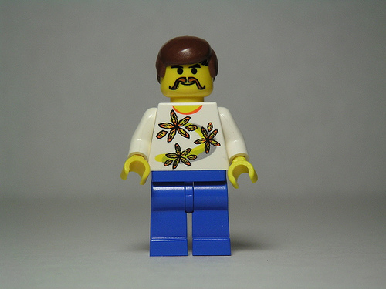
The End

Slide 73
The End Begin

Slide 74
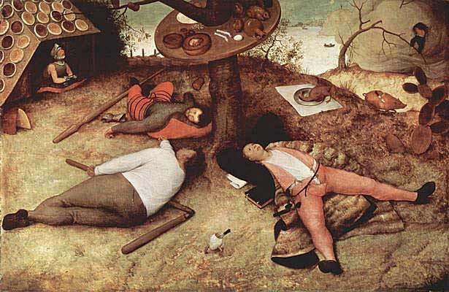
Perl 6 - Land

